Slide 1
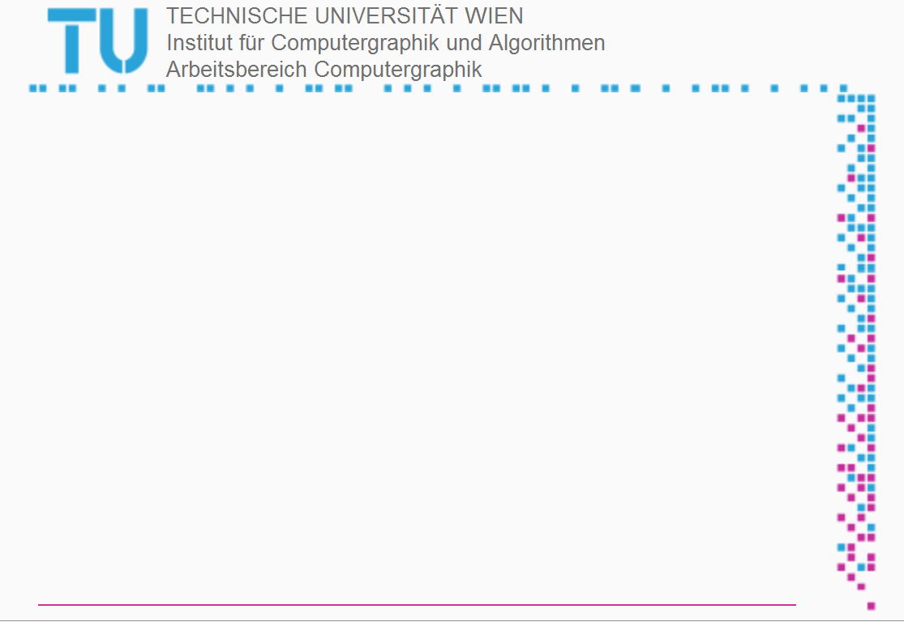
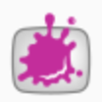
Augmented Reality on Mobile Devices
Intructor
Dr. Michael Gervautz
Dr. Peter Rautek
Christian Möllinger
Ilir Koskija

Slide 2
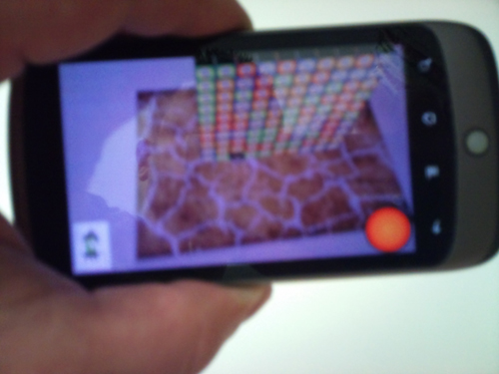
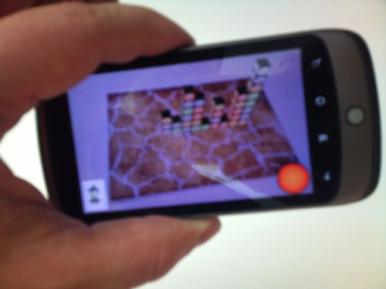
INTRODUCTION
Strategy
try to hit at first less connected blocks so that after the reconfiguration there will result a larger number of connected blocks
In Level 99, have to play Blockd with your money.
many money blocks in a tetris-like stack
to destroy as many as possible

Slide 3
INTRODUCTION
Rule
can destroy 3 or more connected blocks with the same color (by shooting on one of them with the fire button)
can destroy 2 or less connected blocks (with the joker button)
Blocks above destroyed blocks fall down resulting in new configuration of the blocks

Slide 4
INTRODUCTION
Controls!
Point your camera to the game board
center the view on a block.
By tapping the fire button on the lower right or the joker button on the lower left, the blocks at the middle of the screen will be destroyed

Slide 5

INTRODUCTION
Fire Button
the fire button positioned on the lower right.
the fire button can be used to fire at 3 or more with the same color connected blocks!
Fire Button

Slide 6
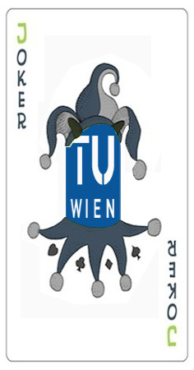
INTRODUCTION
Joker Button
This is the joker button positioned on the lower left.
You can use the fire button to fire at 2 or less with the same color connected blocks!
Joker Button

Slide 7
Thank You for your attendance
Questions?

