Slide 1
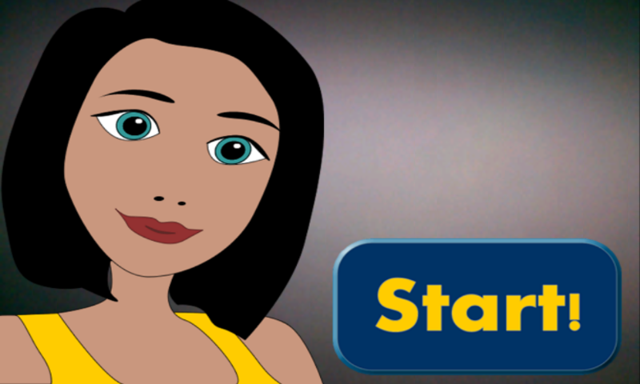
Henpecked man
She wants it!

Slide 2
Idea
One shopping day in the life of Everyman and his girlfriend.
Keep your girl happy by buying her what she wants when she wants it. Find the gifts in the stores of a mall.
The more you buy the happier she will be.

Slide 3
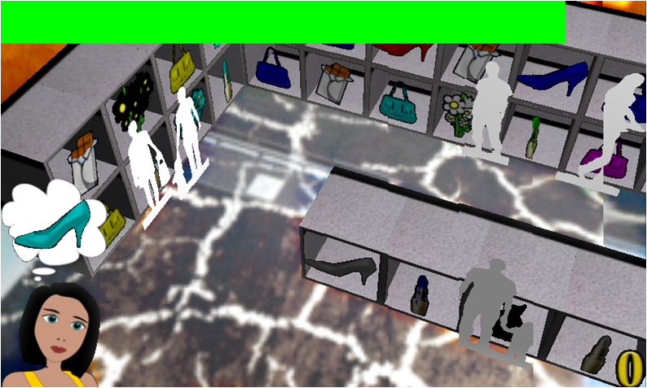
The mall

Slide 4
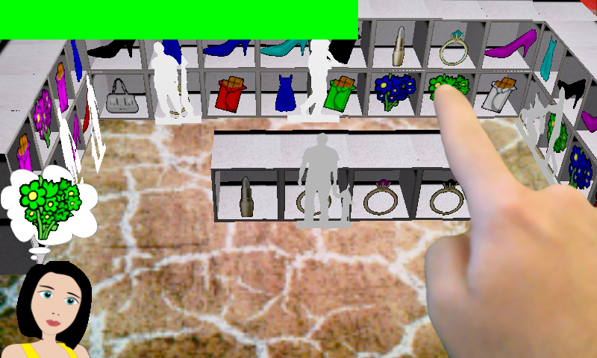
Play
Find the Gift
navigate around the virtual store
girlfriend changes her mind
stores change their stock
people block the sight
Buy the Gift
tap on the object

Slide 5
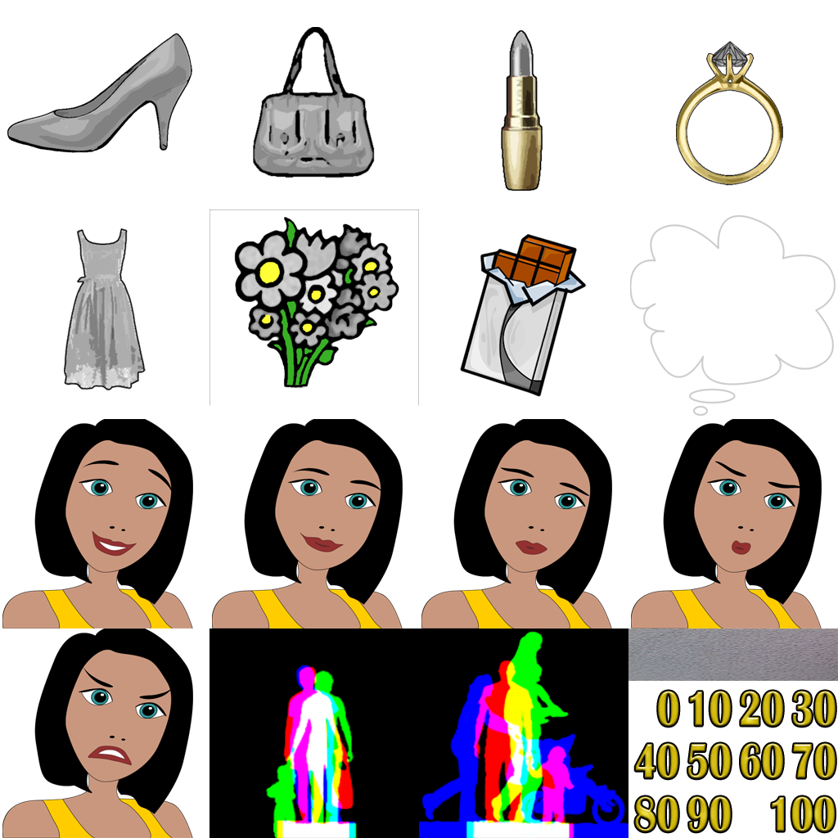
Work
What we did
All-in-One Texture
Item color set in the shader to save texture space
Mall sound volume apropriate to play distance
Alpha picking
Simple geometry
What we did not
Framebuffer Object Picking
More sophisticated geometry
Store opening hours
Post processing effects

Slide 6
Final Thoughts
Simple - Easy - Beautiful
Get to know the platform AND hardware
Explore massive examples offered on the web
Make use of AR possibilities (intuitive navigation, …)

